Slide 1

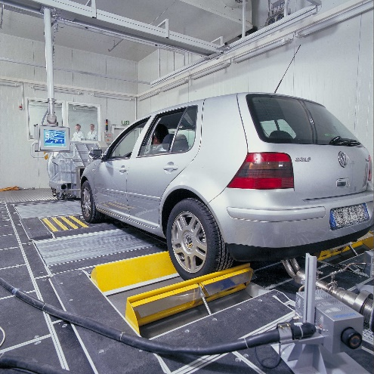

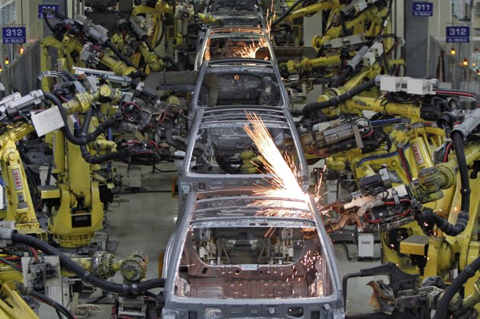
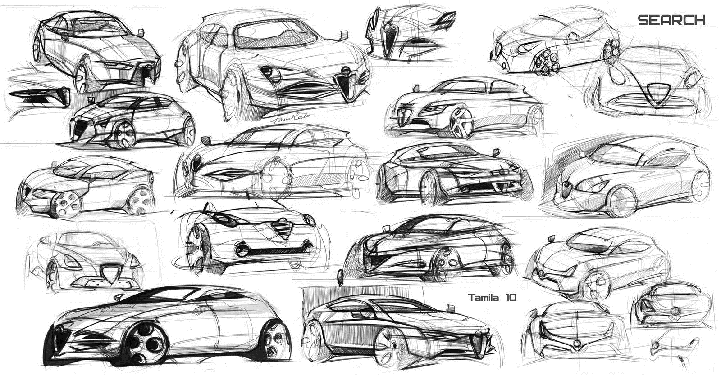
Basics of Vehicle Design

Slide 2





What problem am
I trying to solve?
Speed (v)
V = distance/time

Slide 3
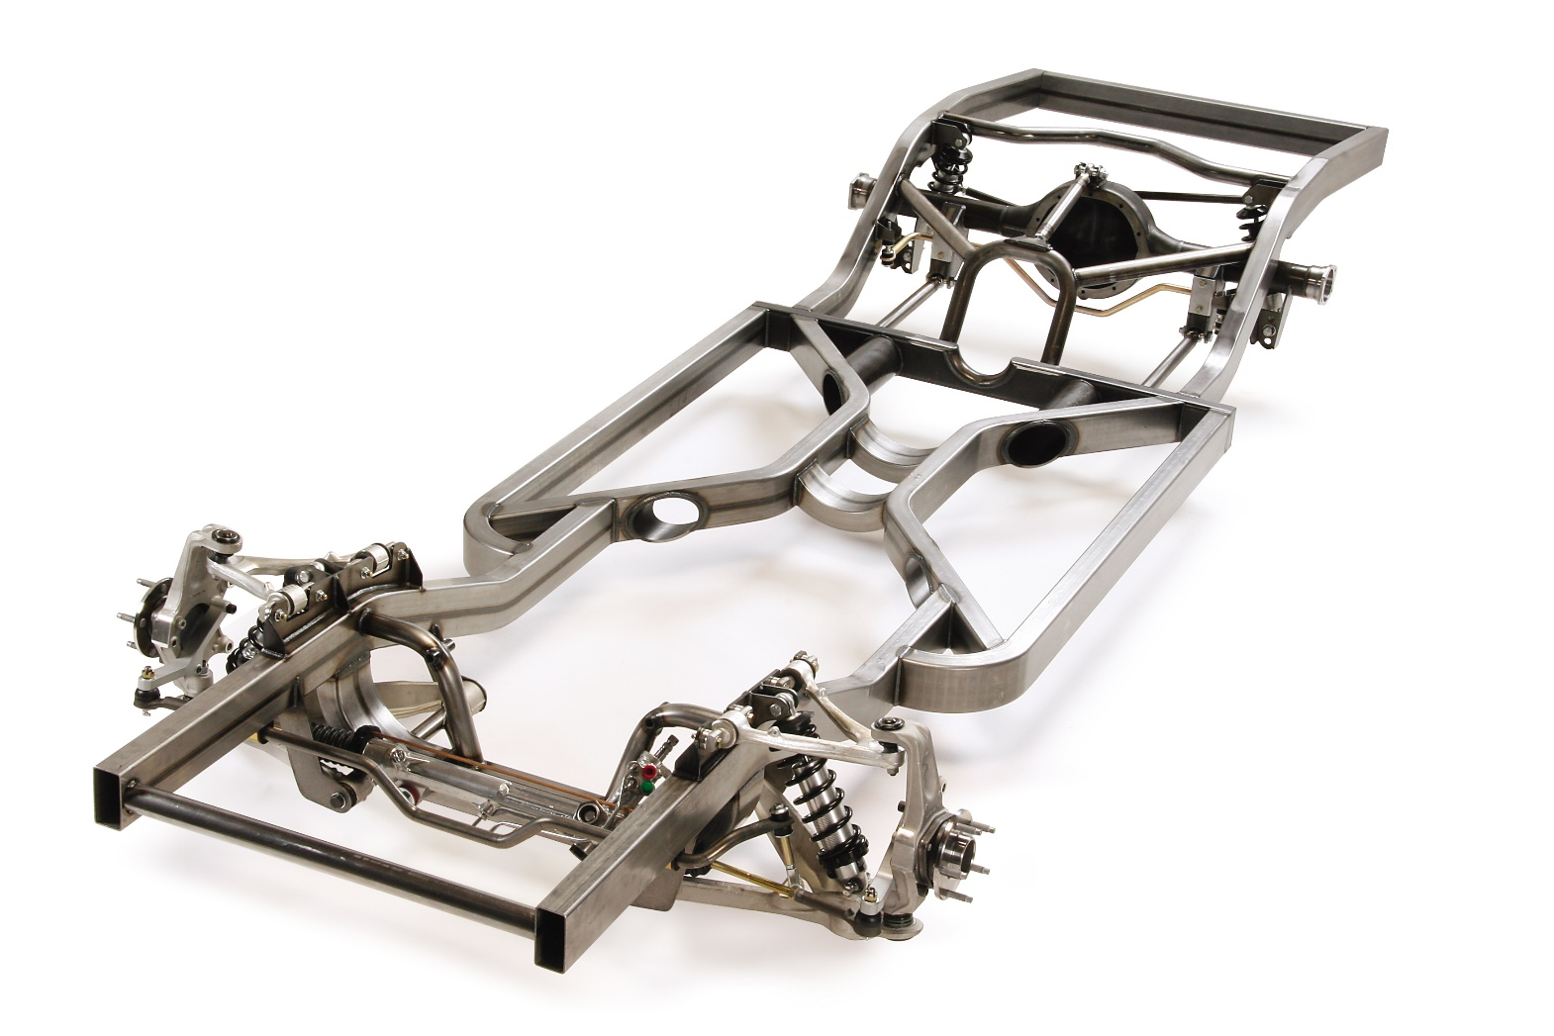
What is a vehicle’s chassis?
The part where the rest of a vehicle’s
components sit or connect to.

Slide 4
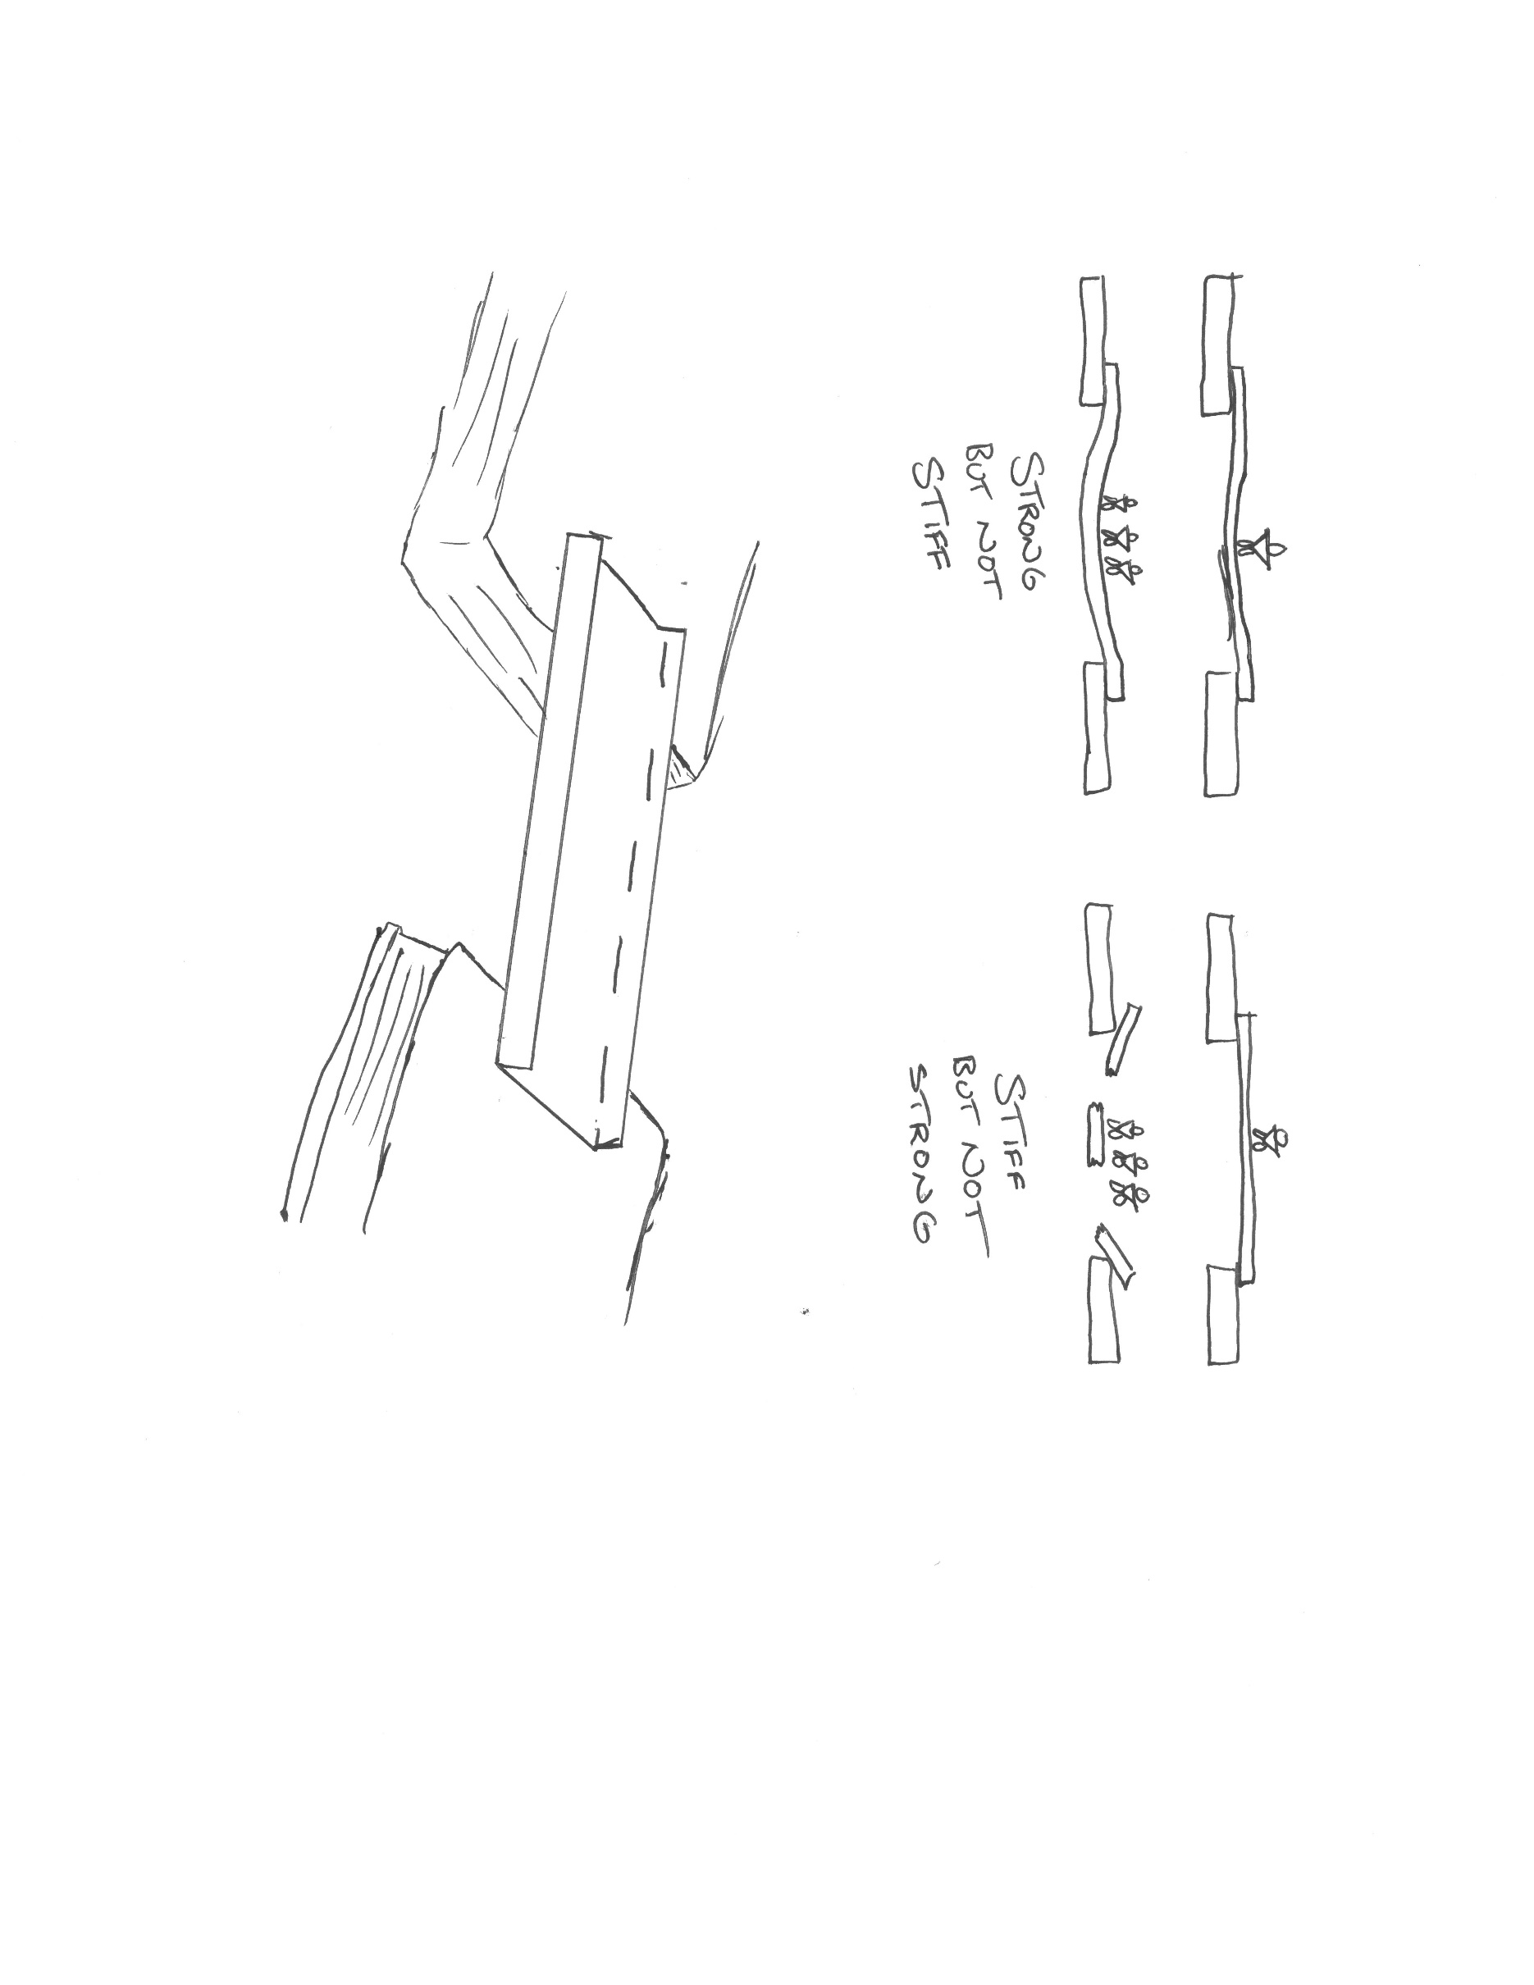
Strength vs. Stiffness

Slide 5


Weight vs. Stiffness

Slide 6
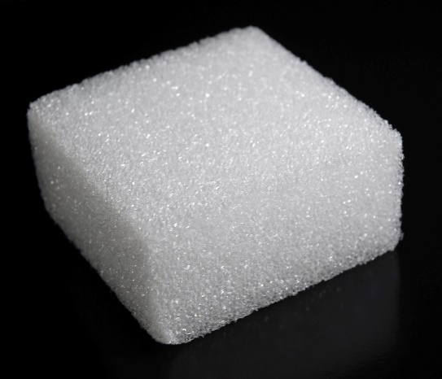
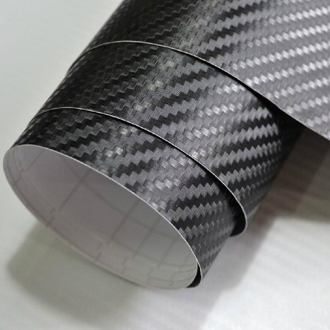
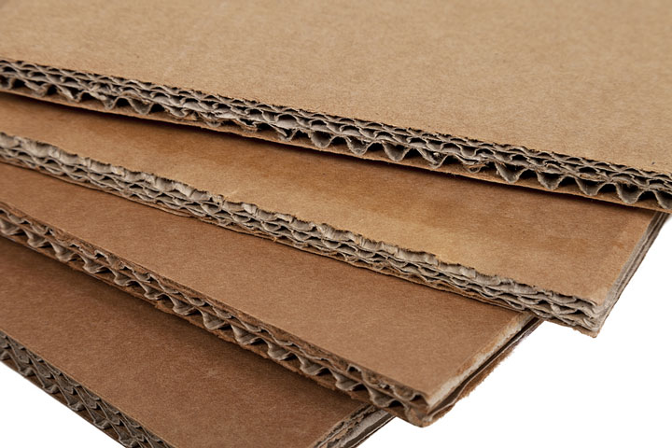
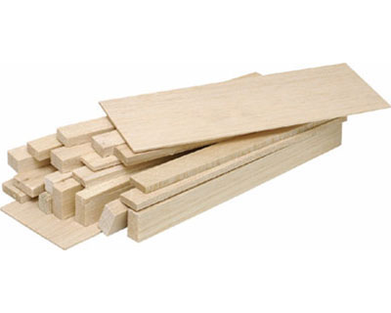
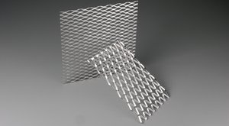
Materials
Can we think of any materials that might provide strength, be light weight AND provide stiffness?
Styrofoam -
$$
Carbon Fiber -
$$$$
Cardboard -
$
Sheet Metal -
$$$
Balsa Wood -
$$

Slide 7

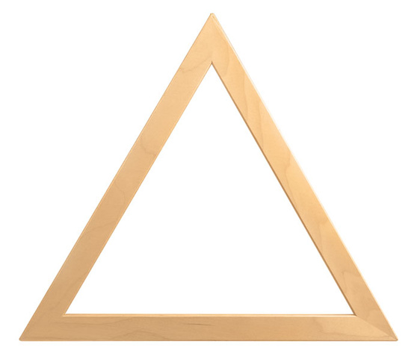
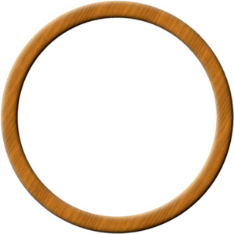
Shape
Which of these shapes is structurally the strongest?
LET’S INVESTIGATE!
Square
Triangle
Circle

